Slide 1
Distributed Systems

Slide 2
Definition of a Distributed System
A distributed system is a collection of independent computers that appear to the users of the system as a single computer
Two aspects:
– Hardware: autonomous machines
– Software: the users think of the system as a single computer

Slide 3
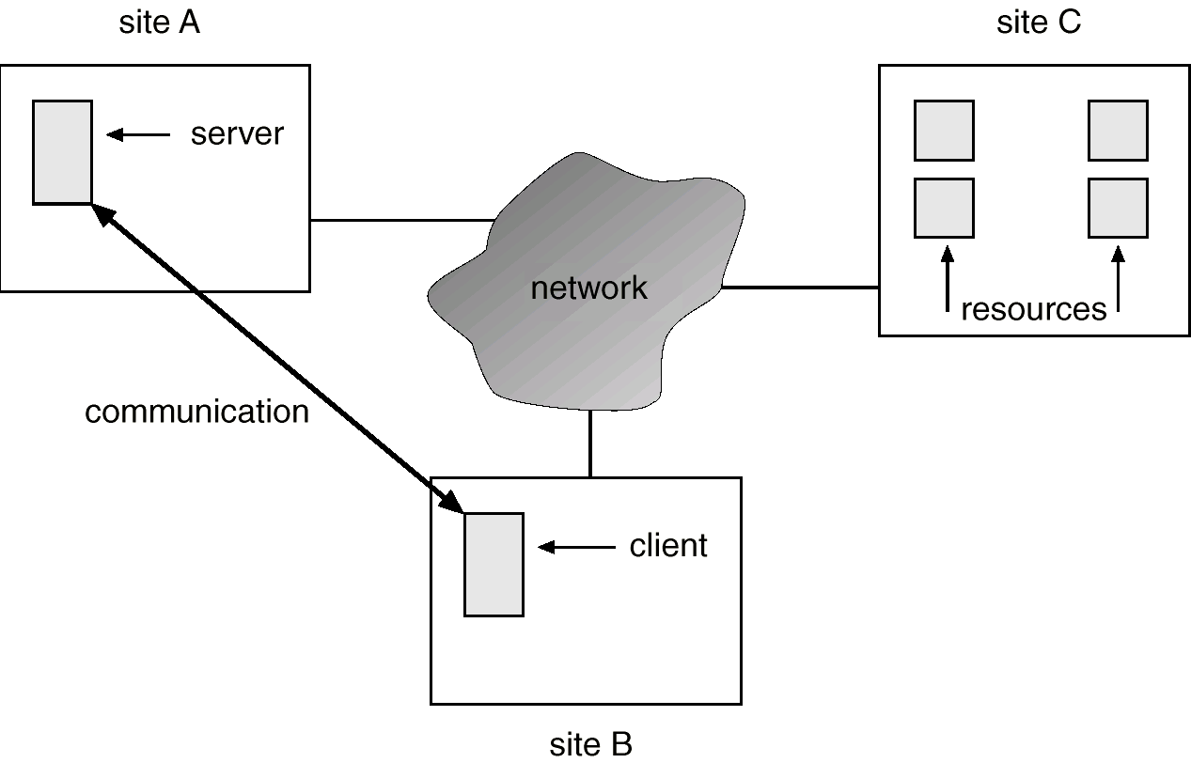
A Distributed System

Slide 4
Motivation
Resource sharing
sharing and printing files at remote sites
processing information in a distributed database
using remote specialized hardware devices
Computation speedup – load sharing
Reliability – detect and recover from site failure, function transfer, reintegrate failed site
Communication – message passing

Slide 5
Network OS
User process
User process
Local OS
Local OS
NOS
NOS
Commn module
Commn module
Computer N/W

Slide 6
Network OS
Users are aware of multiplicity of machines. Access to resources of various machines is done explicitly by:
Remote logging into the appropriate remote machine.
Transferring data from remote machines to local machines, via the File Transfer Protocol (FTP) mechanism.
Characteristics
Local OS
Own computer or designated computer or remote login
Explicit file transfer commands
Little or no fault tolerance

Slide 7
Communication and information sharing
Shared Global File system
Use of file servers
Hierarchical file system

Slide 8
Distributed OS
Users not aware of multiplicity of machines. Access to remote resources similar to access to local resources.
Data Migration – transfer data by transferring entire file, or transferring only those portions of the file necessary for the immediate task.
Computation Migration – transfer the computation, rather than the data, across the system.

Slide 9
Process Migration – execute an entire process, or parts of it, at different sites.
Load balancing – distribute processes across network to even the workload.
Computation speedup – subprocesses can run concurrently on different sites.
Hardware preference – process execution may require specialized processor.
Software preference – required software may be available at only a particular site.
Data access – run process remotely, rather than transfer all data locally.

Slide 10
A DOS should
Control n/w resource allocation
Provide virtual computer
Hide the distribution of resources
Provide protection mechanisms
Provide secure communication

Slide 11
File Server
Print Server
Name Server
Hard Disk
Printer
M/C
Communication Subsystem
PC1
PCn
Proc 1
Procn
User 1
User n
Processing servers

Slide 12
Characteristics
Global system wide OS
Dynamic allocation of processes to CPU’s
File placement managed by OS
Fault tolerance
Single Global IPC mechanism

Slide 13
Middleware based Distributed Systems
Middleware- Additional layer on top of NOS implementing general purpose services and it hides more or less the heterogeneity of the collection of underlying platforms.
Middleware Services:
Communication facilities
Naming
Persistence
Security
Openness
Scalability

Slide 14
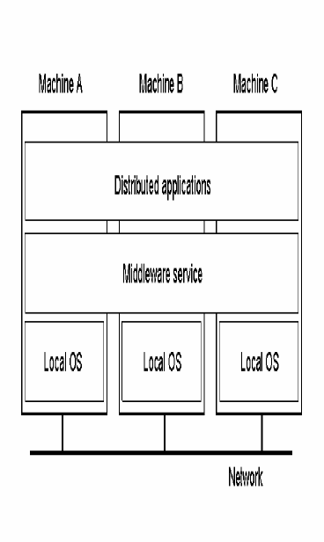
A distributed system organized as middleware.

Slide 15
Goals
A distributed system should easily connect users to resources
It should hide the fact that resources are distributed across a network
It should be open
It should be scalable

Slide 16
Design Issues
Transparency – concealment from the user and the application programmer of the separation of components in a distributed systems so that the system is perceived as a whole rather than as a collection of independent components
Flexibility- ease of modification and ease of enhancement
Openness – The openness of a computer system is the characteristics that determines whether the system can be extended and re-implemented
Scalability – A system is scalable, if it will remain effective when there is a significant increase in the numbers of resources and number of users
Heterogeneity – Variety and differences
Security- CIA
Confidentiality – protection against disclosure to unauthorized individuals
Integrity – Protection against alteration or corruption
Availability – Protection against interference with the means to access the resources.

Slide 17
Distributed Synchronization

Slide 18
Distributed Systems
A distributed system consists of a number of processes.
Each process has a state ( Values of variables)
Each process takes action to change its state, which may be an instruction or a communication action ( send, receive)
Each process has a common clock and events within a process can be assigned timestamps and thus ordered.
In DS, the time order of events across different processes are also to be considered.
The multiple processors do not share a common memory or clock.
Instead, each processor has its own local memory and communicates with other processes through communication lines.

Slide 19
The Importance of Synchronization
Various components of a distributed system must cooperate and exchange information, synchronization is a necessity.
Constraints, both implicit and explicit, are therefore enforced to ensure synchronization of components.
Synchronization is required for
Fairness
Correctness

Slide 20
Clock Synchronization
Logical Clocks
Happened Before relation
Physical Clocks
Centralized
Broadcast Based
Request Driven
Decentralized

Slide 21
Physical Clocks & Synchronization
In a DS, each process has its own clock.
Clock Skew versus Drift
Clock Skew = Relative Difference in clock values of two processes
Clock Drift = Relative Difference in clock frequencies (rates) of two processes
A non-zero clock drift will cause skew to continuously increase.

Slide 22
Implementation of Physical Time Service
Obtaining accurate value when implmenting a physical time service
Synchronizing the concept of physical time throughout the distributed system.
Implementation
Centralized
Distributed

Slide 23
Centralized Physical service
Broadcast based
Request driven
Problems
Single point of failure
Traffic around server increases
Not scalable

Slide 24
Distributed Physical service
Client broadcast its current time at predefined set intervals
Starts timer
Collects messages
Calculates average values and then adjust time values.

Slide 25
Process Synchronization
Techniques to coordinate execution among processes
One process may have to wait for another
Shared resource (e.g. critical section) may require exclusive access

Slide 26
Mutual Exclusion
Centralized
Distributed
Lock-based (aka permission based, non-token based) - to enter the CS a process needs to obtain permission from other processes in the system.
Token-based - unique token (privilege) circulated in the system. A process possessing the token can enter CS

Slide 27
Centralized Algorithm
One process is elected as the coordinator.
When any process wants to enter a critical section, it sends a request message to the coordinator stating which critical section it wants to access.
If no other process is currently in that critical section, the coordinator sends back a reply granting permission. When the reply arrives, the requesting process enters the critical section. If another process requests access to the same critical section, it is ignored or blocked until the first process exits the critical section and sends a message to the coordinator stating that it has exited.

Slide 29
Distributed Algorithm – Permission based
When a process wants to enter a critical section, it builds a message containing the name of the critical section, its process number, and the current time. It then sends the message to all other processes, as well as to itself.

Slide 30
When a process receives a request message, the action it takes depends on its state with respect to the critical section named in the message. There are three cases: If the receiver is not in the critical section and does not want to enter it, it sends an OK message to the sender.
If the receiver is in the critical section, it does not reply. It instead queues the request.
If the receiver also wants to enter the same critical section, it compares the time stamp in the incoming message with the time stamp in the message it has sent out. The lowest time stamp wins. If its own message has a lower time stamp, it does not reply and queues the request from the sending process.
When a process has received OK messages from all other processes, it enters the critical section. Upon exiting the critical section, it sends OK messages to all processes in its queue and deletes them all from the queue.

Slide 31
Token Based Algorithm
Another approach is to create a logical or physical ring.
Each process knows the identity of the process succeeding it.
When the ring is initialized, Process 0 is given a token. The token circulates around the ring in order, from Process k to Process k + 1.
When a process receives the token from its neighbor, it checks to see if it is attempting to enter a critical section. If so, the process enters the critical section and does its work, keeping the token the whole time.

Slide 32
After the process exits the critical section, it passes the token to the next process in the ring. It is not permitted to enter a second critical section using the same token.
If a process is handed a token an is not interested in entering a critical section, it passes the token to the next process.

Slide 34
Distributed File System

Slide 35
DISTRIBUTED FILE SYSTEMS
Clients, servers, and storage are dispersed across machines. Configuration and implementation may vary –
Servers may run on dedicated machines, OR
Servers and clients can be on the same machines.
The OS itself can be distributed (with the file system a part of that distribution).
A distribution layer can be interposed between a conventional OS and the file system.
Clients should view a DFS the same way they would a centralized FS; the distribution is hidden at a lower level.
Performance is concerned with throughput and response time.

Slide 36
Goals
Network transparency: users do not have to aware the location of files to access them
location transparency: the name of a file does not reveal any kind of the file's physical storage location.
/server1/dir1/dir2/X
server1 can be moved anywhere
location independence: the name of a file does not need to be changed when the file's physical storage location changes.
The above file X cannot moved to server2 if server1 is full and server2 is no so full.
High availability: system failures or scheduled activities such as backups, addition of nodes

Slide 37
Architecture
Computation model
file servers -- machines dedicated to storing files and performing storage and retrieval operations (for high performance)
clients -- machines used for computational activities may have a local disk for caching remote files
Two most important services
name server -- maps user specified names to stored objects, files and directories
cache manager -- to reduce network delay, disk delay problem: inconsistency
Typical data access actions
open, close, read, write, etc.

Slide 38
Data access in a distributed system
Client side
Client request to access data
Check client cache
Data present Return to client
Else Check local disk
Data present Return to client
Else Send request to file server through n/w

Slide 39
Server side
Check server cache
Data present ; load data to client cache through n/w; return to client.
Else Issue disk read; Local server cache; load data to client cache through n/w; return to client.

Slide 40
Distributed File system design
File service vs. file server
File service interface: the specification of what the file system offers to its clients.
Implemented by a user/kernel process called file server
File server: a process that runs on some machine and helps implement the file service.
A system may have one or several file servers running at the same time

Slide 41
Remote Files
What is a file?
Uninterpreted sequence of bytes
Can be structured as a sequence of records
Files can have attributes
Owner, size, creation date and access permissions
File model
Files can be modified or
Immutable files
File Protection
Capability
Access control list
File Service Model
upload/download model
files move between server and clients, few operations (read file & write file), simple, requires storage at client, good if whole file is accessed
remote access model
files stay at server, reach interface for many operations, less space at client, efficient for small accesses

Slide 42
Directory Service
The directory service
creating and deleting directories
naming and renaming files
moving files
Clients can have the same view (global root directory)
or different views of the file system (remote mounting)

Slide 43
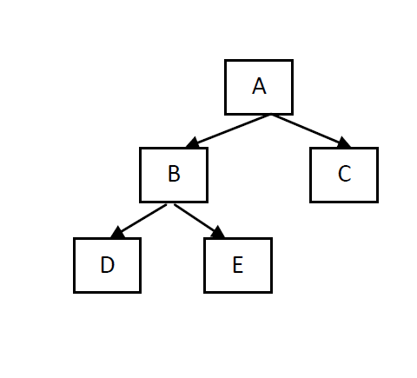
Hierarchical file system
Directory Tree

Slide 44
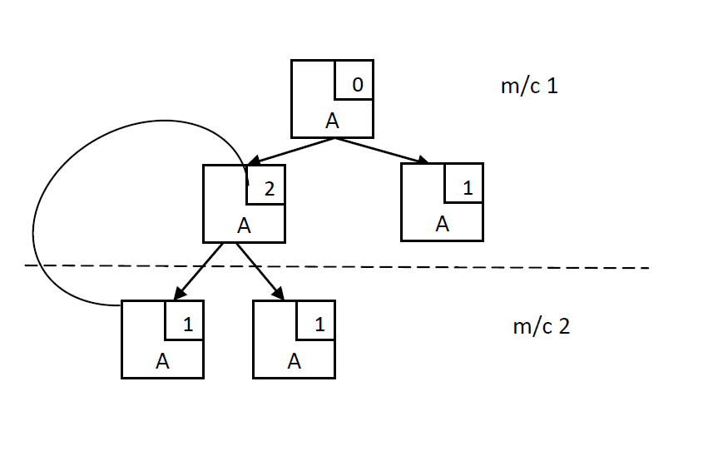
Directory Graph

Slide 45
Naming and Name Resolution
a name space -- collection of names
name resolution -- mapping a name to an object
same or different view of a directory hierarchy
3 traditional ways to name files in a distributed environment
concatenate the host name to the names of files stored on that host: system-wide uniqueness guaranteed, simple to located a file; however, not network transparent, not location independent, e.g., /machine/usr/foo
mount remote directories onto local directories: once mounted, files can be referenced in a location-transparent manner
provide a single global directory: requires a unique file name for every file, location independent, cannot encompass heterogeneous environments and wide geographical areas

Slide 46
Two-Level Naming
Symbolic name (external), e.g. prog.c; binary name (internal), e.g. local i-node number as in Unix
Directories provide the translation from symbolic to binary names
Binary name format
i-node: no cross references among servers
(server, i-node): a directory in one server can refer to a file on a different server
Capability specifying address of server, number of file, access permissions, etc
{binary_name+}: binary names refer to the original file and all of its backups

Slide 47
File Sharing Semantics
UNIX semantics:
Total ordering of R/W events
Value read is the value stored by last write
Writes to an open file are visible immediately to others that have this file opened at the same time.
Easy to achieve in a non-distributed system ; In a distributed system with one server and multiple clients with no caching at client.

Slide 48
Session semantics:
Writes to an open file by a user is not visible immediately by other users that have files opened already. Once a file is closed, the changes made by it are visible by sessions started later.
Writes are guaranteed to become visible only when the file is close
Allow caching at client with lazy updating -> better performance
If two or more clients simultaneously write: one file (last one or non-deterministically) replaces the other

Slide 49
Immutable files:
create and read file operations (no write) - i.e. a sharable file cannot be modified. File names cannot be reused and its contents may not be altered. Simple to implement.
Writing a file means to create a new one and enter it into the directory replacing the previous one with the same name: atomic operations
Collision in writing: last copy or nondeterministically

Slide 50
Transaction semantics:
mutual exclusion on file accesses; either all file operations are completed or none is. Good for banking systems
All changes have all-or-nothing property. W1,R1,R2,W2 not allowed where P1 = W1;W2 and P2 = R1;R2

Slide 51
Distributed File system Implementation
System Structure
Clients and servers on different machines?
Combine File and directory services
Keep them separate
Lookups
Iterative lookup
Automatic lookup

Slide 52
Stateless vs. Stateful
Stateless Server
Stateful Servers
requests are self-contained
better fault tolerance
open/close at client (fewer msgs)
no space reserved for tables
thus, no limit of open files
no problem if client crashes
shorter messages
better performance (info in memory until close)
open/close at server
file locking possible
read ahead possible

Slide 53
Caching
Four places to store files
server’s disk: slow performance
eliminates coherence problem
server caching: in main memory
cache management issue, how much to cache, replacement strategy
still slow due to network delay
Used in high-performance web-search engine servers

Slide 54
Client caching in main memory
can be used by diskless workstation
faster to access from main memory than disk
compete with the virtual memory system for physical memory space
avoids disk access but still network access
Three Options
inside each process address space: no sharing at client
in the kernel: kernel involvement on hits
in a separate user-level cache manager: flexible and efficient if paging can be controlled from user-level

Slide 55
client-cache on a local disk
large files can be cached
the virtual memory management is simpler
a workstation can function even when it is disconnected from the network

Slide 56
Update algorithms for client caching
write-through:
all writes are carried out immediately
writes sent to the server as soon as they are performed at the client -> high traffic, requires cache managers to check (modification time) with server before can provide cached content to any client
Reliable: little information is lost in the event of a client crash
Slow: cache not that useful
delayed-write:
delays writing at the server
coalesces multiple writes; better performance but ambiguous semantics
possible to perform many writes to a block in the cache before it is written
if data is written and then deleted immediately, data need not be written at all (20-30 % of new data is deleted with 30 secs)

Slide 57
write-on-close:
delay writing until the file is closed at the client
Implements session semantics
if file is open for short duration, works fine
if file is open for long, susceptible to losing data in the event of client crash
Central control:
file server keeps a directory of open/cached files at clients -> Unix semantics, but problems with robustness and scalability; problem also with invalidation messages because clients did not solicit them

Slide 58
Cache Coherence
How to maintain consistency between locally cached data with the master data when the data has been modified by another client?
Client-initiated approach -- check validity on every access: too much overhead first access to a file (e.g., file open) every fixed time interval
Server-initiated approach -- server records, for each client, the (parts of) files it caches. After the server detects a potential inconsistency, it reacts.
Not allow caching when concurrent-write sharing occurs. Allow many readers. If a client opens for writing, inform all the clients to purge their cached data.

Slide 59
Potential inconsistency:
In session semantics, a client closes a modified file.
In UNIX semantics, the server must be notified whenever a file is opened and the intended mode (read or write mode) must be indicated for every open.
Disable cache when a file is opened in conflicting modes.

Slide 60
Replication

Slide 61
File Replication
Multiple copies are maintained, each copy on a separate file server
Reasons:
To improve reliability; availability and performance.
Replication transparency
explicit file replication: programmer controls replication
lazy file replication: copies made by the server in background
use group communication: all copies made at the same time in the foreground

Slide 62
Explicit File Replication
S1
File : 1.14 : 2.16 : 3.19
Pl : 1.2.1 : 2.43 : 3.41
C
S2
S3

Slide 63
Lazy replication
S1
S2
C
S3

Slide 64
File replication using Group
S1
S2
C
S3

Slide 65
Update protocols
Primary Copy Replication
Voting
Voting with ghosts

Slide 66
Modifying Replicas: Voting Protocol
Updating all replicas using a coordinator works but is not robust (if coordinator is down, no updates can be performed) => Voting: updates (and reads) can be performed if some specified # of servers agree.
Voting Protocol:
A version # (incremented at write) is associated with each file
To perform a read, a client has to assemble a read quorum of Nr servers; similarly, a write quorum of Nw servers for a write
If Nr + Nw > N, then any read quorum will contain at least one most recently updated file version
For reading, client contacts Nr active servers and chooses the file with largest version #
For writing, client contacts Nw active servers asking them to write. Succeeds if they all say yes.

Slide 67
Voting Protocol with Ghosts
Nr is usually small (reads are frequent), but Nw is usually close to N (want to make sure all replicas are updated). Problem with achieving a write quorum in the presence of server failures
Voting with ghosts: allows to establish a write quorum when several servers are down by temporarily creating dummy (ghost) servers (at least one must be real)
Ghost servers are not permitted in a read quorum (they don’t have any files)
When server comes back it must restore its copy first by obtaining a read quorum

